Slide 1
Morpheme Decomposer in English and hungarian
By: Pfeifer Dániel

Slide 2
About morphemes
Morpheme = Smallest part of the word that contains meaning
Morphemes = Word stem, affixes.
English:
interestingly = interesting (adjective) + ly (adverb marker)
Hungarian:
kutyátokhoz = kutya (noun) + tok (possession marker Plural/2) + hoz (relation marker affix)

Slide 3
Automatic decomposition
Option 1:
Program all of grammar (viable method for English, with not too many affixes attached to a word).
Option 2:
Use a Neural Network that can find and learn these affixes.

Slide 4
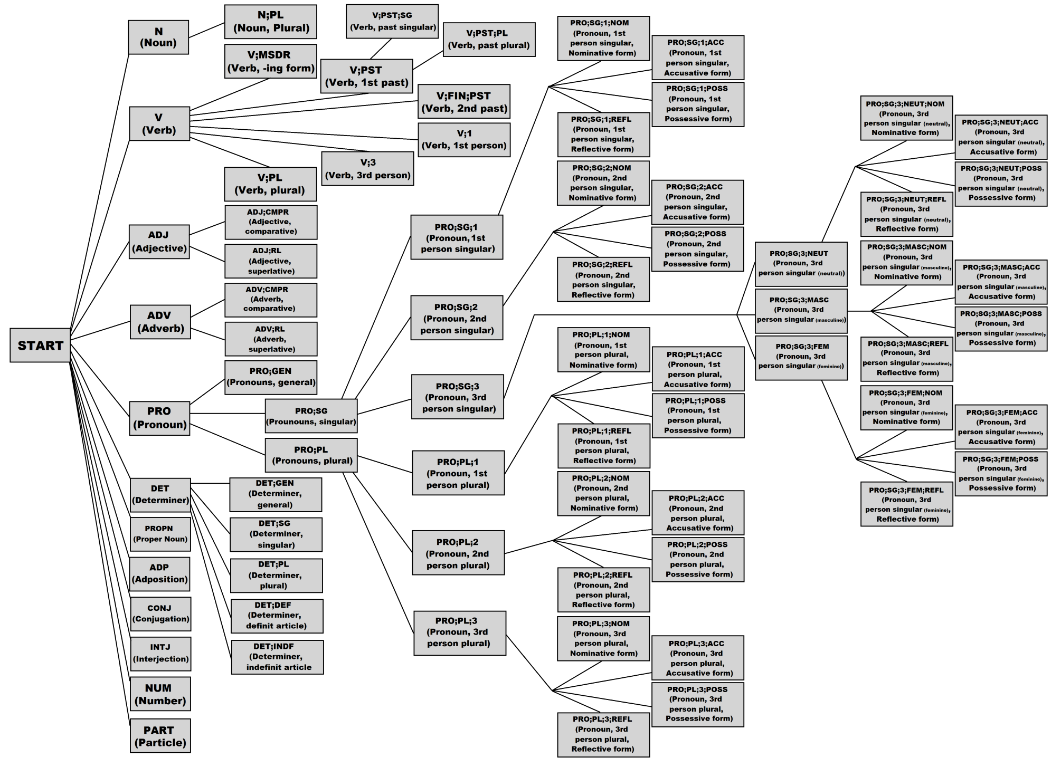
morpheme tree in english

Slide 5
Hungarian morphemes
HUNGARIAN MORPHEME TREE: Wouldn’t be able to see individual rectangles, it would be way too large.
3 types of affixes (képző , jel, rag).
These are only the rag’s for nouns:
accusative marker: -t
possessive marker: -nak, nek
other markers: -ban, -ben, -ba, -be, -ból, -ből, -n, -on, -en, -ön, -ra, -re, -ról, -ről, -nál, -nél, -hoz, -hez, -höz, -tól, -től, -val, -vel, -kor, -nak, -nek, etc. ....
→ Neural Network models instead!

Slide 6
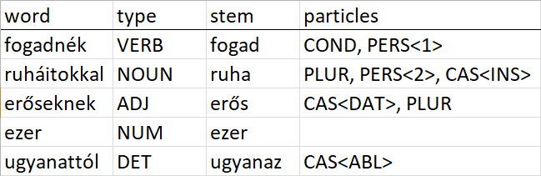
Data
Given a Data Frame of words that are already decomposed correctly, e.g.:
Origin: ftp://ftp.mokk.bme.hu/Language/Hungarian/Corp/Webcorp/ana/
These are words used on the internet on various websites, labelled by a different morpheme decomposer.
Advantage: A LOT of entires (~5,000,000)
Disadvantage: MANY non-dictionary words and typos like „aaaggghhh”, „fincsibe”, „szoklyák”, „jajjdejó”, etc.

Slide 7
Data transformations
Word encoding
Possible characters are:
0123456789.:,;!%&'*_=~\\()|[]{}aáäbcdeéfghiíjklmnoóöőpqrstuúüűvwxyz (and space)
68 different characters: Character dictionary with:
Space → 0 0 → 1 1 → 2 2 → 3 ... z → 68

Slide 8
Data transformations
Affix encoding:
A noun can have 77 unique affixes, and multiple combinations of them.
Encoding: Into a 77 element 0-1 vector, eg.:
(0, 0, 0, 0, 1, 0, 0, 0, 0, 0, 0, 0, 1, 0, 0, 0, 0, 1, 1, 0, 0, 0, 0, 0, ... 0,)
An element is 1, if the given affix appears on the noun, 0 otherwise.
Same for verbs, adjectives, determiners and numbers, except they might have a different number of possible affixes (instead of 77).

Slide 9
Neural network inputs & outputs
Input:
Encoded word – list of numbers from 0 to 67 one hot encoded.
The longest Hungarian word is „megszentségteleníthetetlenségeskedéseitekért”, which has 44 letters, so the input shape is (44,67). So for a shorter word, the rest is filled out with 0’s.
Output:
A 0-1 vector of length = number of possible affixes.

Slide 10
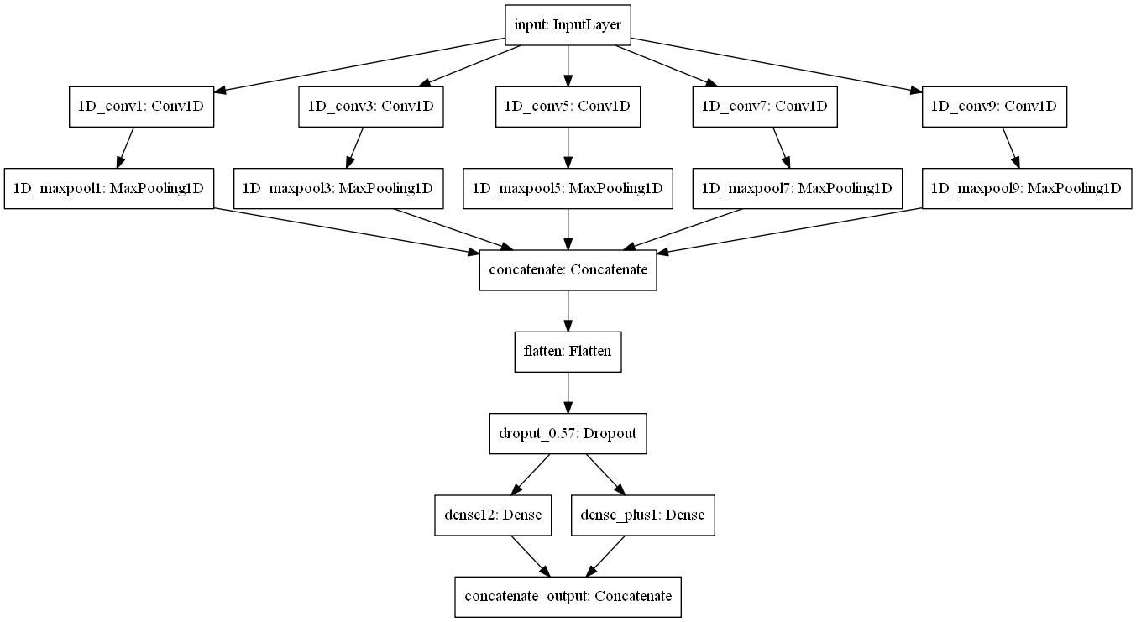
Neural network structurE

Slide 11
Neural network structurE
Convolutional Layers :
Filter sizes: 1x1, 3x1, 5x1, 7x1, 9x1

Slide 12
Neural network structure
Max Pooling Layers :
Pool sizes: 1x1, 2x1, 2x1, 4x1, 4x1

Slide 13
Neural network structurE
Concatenate Layer

Slide 14
Neural network structurE
Flatten Layer

Slide 15
Neural network structurE
57% Dropout Layer

Slide 16
Neural network structurE
Dense Layers with outputs that predict:
all the attached morphemes (1x77 vector)
length of word stem

Slide 17
Neural network structurE
Final concatenated Layer

Slide 18
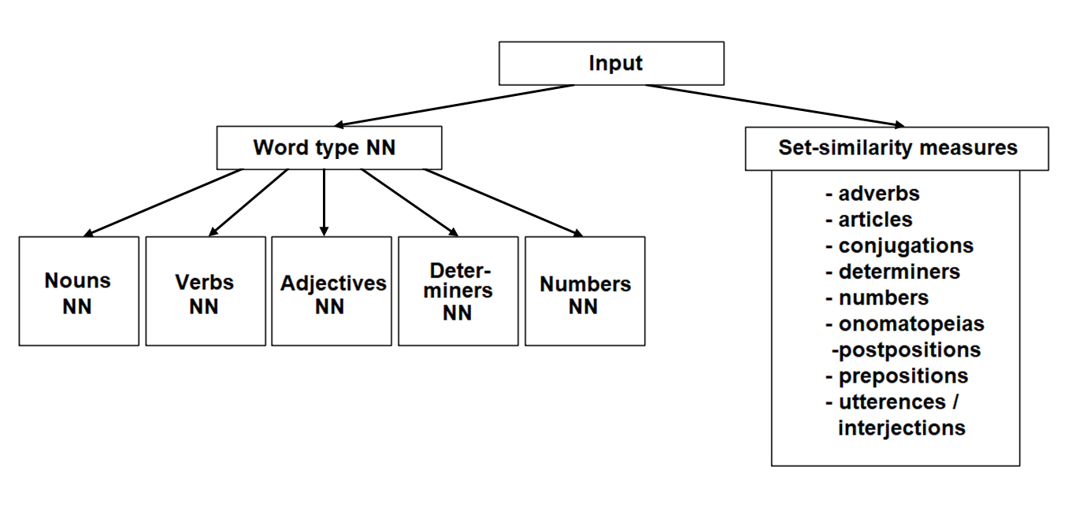
Using the previous Neural network

Slide 19
Using the previous Neural network
Each one is exactly the same layout as the previously shown Neural Network, except the Word type NN:
doesn’t have a separate word stem length Neuron and
Uses softmax instead of sigmoid activation

Slide 20
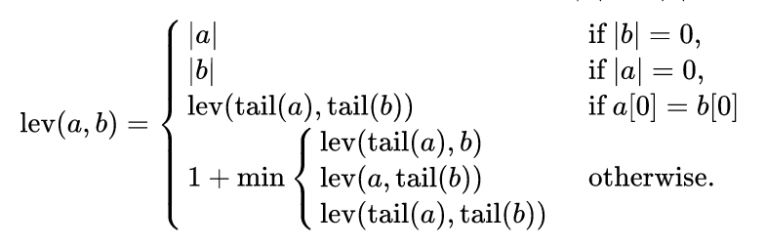
Set similarity measures
I didn’t have sufficient data for the previous mentioned word types.
And they can’t be decomposed into further morphemes anyway.
Word similarity: Lehvenstein distance

Slide 21
Set similarity measures
Set similarity ≈ Average word similarity
Issues with this:
„többször” is a numeral, but it’s very dissimilar to other numerals.
The larger the set, the smaller the average word similarity will be for a given word.
The Lehvenstein-distance will give a small value if the average length of words in the set is small (let’s say ~8), but the length of our word is long (let’s say ~20). E.g.: „eltéveszthetetlenül” is an Adverb, but most Adverbs are much shorter.

Slide 22
Set similarity measures
Solutions:
If the word is in the set, its set-similarity is automatically 1.
If the word is very similar to one (or a few) words in the set, its set-similarity should be higher → count the proportion of words in the set for which its Lehvenstein-distance is > 0.5.
If a word is very long, cutoff the first bit and test the similarity on the last k letters, where k is the average length of the set. Then: similarity = (regular similarity + cut similarity) / 2.

Slide 23
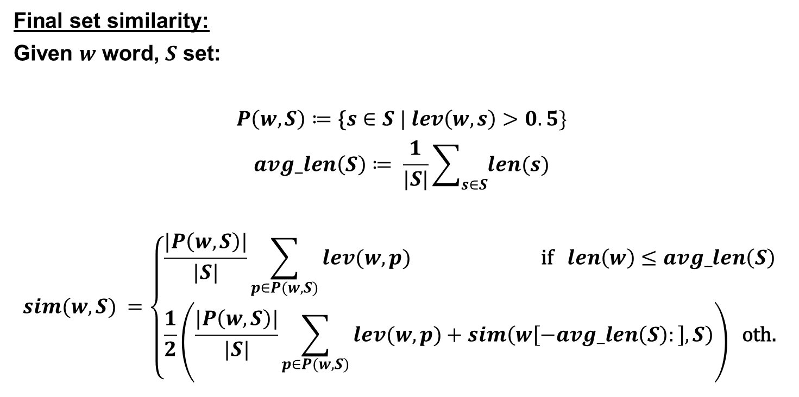
Set similarity measures
Final set similarity:
Given $w$ word, $S$ set:
$$P\left(w,S\right)≔\text{\{}s∈S | lev\left(w,s\right)>0.5\}$$
$$avg_len\left(S\right)≔ \frac{1}{|S|}\sum_{s∈S}{len(s)}$$
$$sim(w,S) =\left\{\begin{aligned}\frac{|P\left(w,S\right)|}{|S|}\sum_{p∈P(w,S)}{lev(w,p)} \text{if} len\left(w\right)≤avg_len\left(S\right) \\ \frac{1}{2}\left(\frac{|P\left(w,S\right)|}{|S|}\sum_{p∈P(w,S)}{lev(w,p)}+sim\left(w\left[−avg_len\left(S\right):\right],S\right)\right) \text{oth}\text{.}\end{aligned}\right.$$

Slide 24
Putting everything together
Before training the Neural Networks, I removed all words containing „kutya” and „nap”, to see how well the model does on them.
For each Neural Network prediction and Set-similarity prediction I defined a cutoff value:
If the prediction was < cutoff, then the given word isn’t of the type that the Neural Network or Set-similarity measure predicted.
Joined all of the possible word types, and for nouns, verbs, adjectives, determiners and numbers, added the most likely decomposition.
Finally, if no value was larger than any predefined cutoff, then I predicted the most likely word type that the Word Type Neural Network gave.

Slide 25
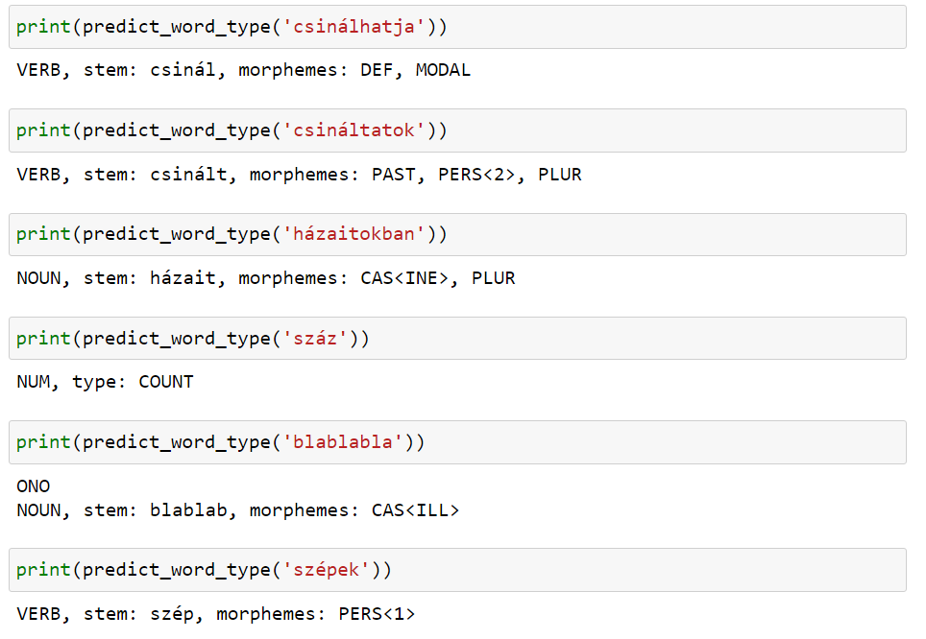
results

Slide 26
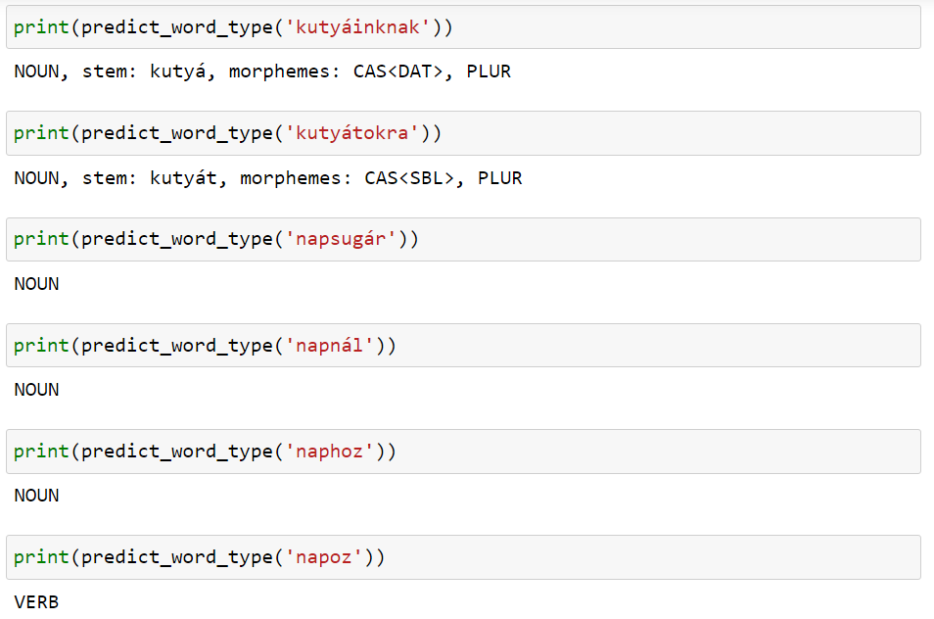
results

Slide 27
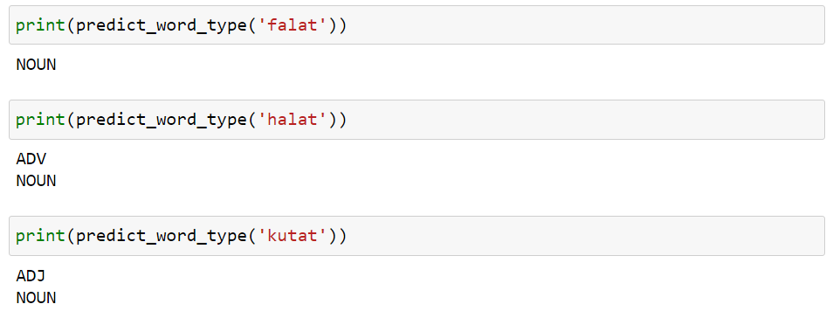
It’s not perfect though....
For some Nouns, it completely misses the point.
Without knowing the stem of each word (having a dictionary), it’s really difficult to know what each word actually means.
If I had built in a dictionary, it could have realised that „halat” contains an accusative marker, and that „kutat” is a verb, not an adjective or a noun.

Slide 28
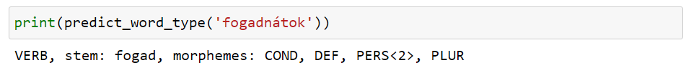

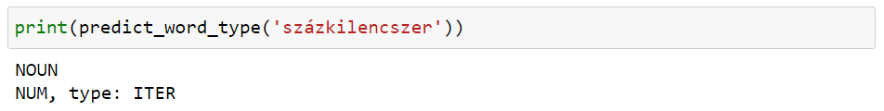
Best and worst performances
The model performs by far the best on verbs:
And worst on unknown nouns, adverbs and numerals. For example:
Even though „százkilencszer” does get recognized:

Slide 29
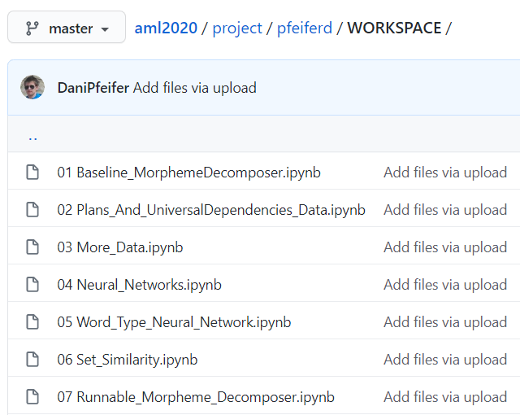
The code
Up on GitHub:
This is a runnable Notebook that I showed the previous results from

Slide 30
THANK YOU FOR YOUR ATTENTION

Slide 31
questions

